Slide 1
WuShock Go
SENIOR DESIGN PROJECT I MIDTERM PRESENTATION
FALL 2021

Slide 2
Team members and Roles :
Tabor Mobile App Dev
Team Lead: Karishma Bhakta (CS)
Front-end 1 (UI / UX Design): Tan Tran (CS)
Front-end 2: Dan Khuu (CS)
Back-end: Sriram Srinivasan (CS)
Full-stack: Fitri Rozi (CS)
Notes:
App---We will be creating a mobile app for Tabor College. Dr. Rangel at Tabor College is looking to create an app for their students that will provide information such as events, phone numbers, and other helpful links. The main target of the app is Tabor students who can have a chance to be more involved on campus and be more connected.

Slide 3
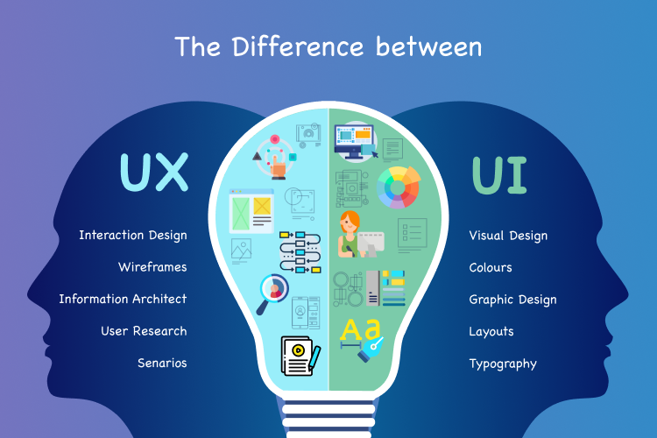
UI / UX Designs - Tan Tran
Target : Students on campus and Alumni
One Stop App : Registar, News feeds, Campus Events, Academics, Students Activities ( Dinning, sports, athletic events, education events,etc.)
Personalize : Font size & styles, Theme, Icons, and Accessibility (ADA)
Structure : Simple, informations all gather in specific area.
Goals : We want a place for students to get information without searching around from multiple sources. To make this product long lasting and that it doesn’t need to be manipulated often. A robust Application.
Create a prototype/mockup using Figma, a software tool for designing our app
Notes:
Who is this application for ? This will be for the students on campus and for Alumni to use
What will be display? Our mobile application will be similar to a One-Stop-app that will include Registar, news feed, campus events, academic, students activities. As we gain more information from our sponsor, we will add or remove these features.
We want to personalize this based on users needs such as, Font size & styles, Theme, icon and accessibility. For example. Some users need larger fonts to see and a style that is simplistic(a clean and intuitive design), also the theme color, icon cannot be something else. It needs to follow the schools requirements. (For ex, the school has blue jay as their logo/(maskot) and the theme color is dark blue & yellow therefore we will be trying to match that as much as possible.)
We also want to make sure there is accessibility for users. This app is intended for a school therefore we need to comply with American Disability Act requirements. This includes for the text legibility,colors(for visual impaired user), error suggestion and much more. For the American Disability Act requirements we are still awaiting for the sponsor confirmation whether we should include or not include.
We have to taken into account of how students and older user like the structure of the app to looks like.
For structure design we want to make it as simple as possible, easier to use, and informations all gather in specific area.
Therefore, We want a place for students to get information without searching around from multiple sources. An application that doesn’t need to be manipulated often…. A robust Application(That doesn’t break easily).
We will be using Figma, a software tool for designing a prototype/mockup of what our app will look like. To make sure we all/including sponsor agree w/ the design and layout before heading to development.
Now, Dan will talk more about Front End.

Slide 4
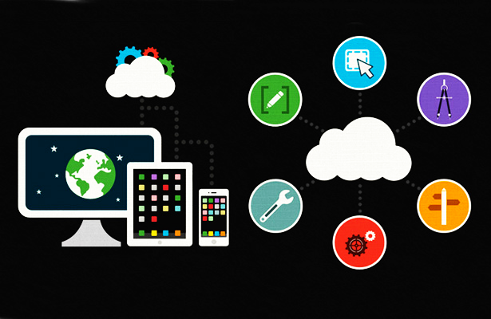
Front End - Dan Khuu
Requirements :
Multi-platform : IOS & Android
Simplistic design
Static or Dynamic
Utilize UI Libraries
Use React Native
Expo tool kit
Great for testing
Programming language: JavaScript
Most commonly used frontend language. Easy to understand if IT workers want to see the code
Mobile responsive (supports phone, tablet, and larger screen sizes)
Notes:
What is our requirements? Our requirement is to make a mobile application that is compatible for IOS and Android.
The requirement for the design have to be simplistic.
It is meaning no animation nor too much fancy/color to the front menu.
Also, keeping the menu and buttons as organize as possible.
Will this app be a static or dynamic? The app will be dynamic but the content that we will be pulling from, its will be static.
We will be relying on third party UI library for our design layout.
For ex. We can use multiple library rather building our own. This way to reduce development time and avoid bugs.
In order to make this app a multi platform we will use the React Native.
It is a JavaScript Framework that allows us to create a truly native app that doesn’t compromise the user experience.
Within this Framework there is an Expo toolkit that will allow us to test the product.
The main language is JavaScript. It is commonly use language that is easy to understand and most of our team is familiar with it.
It is also allow I.T. and follow on teams to pick up the language with low learning curve.
For mobile responsiveness, we have to consider how the app will support older mobile operating system.
(For ex. Will it support all the way back to older android version or iphone 4, 5 or 6?) This requirements is still in discussion with our sponsor.
Also, we have to take in consideration on how to make it responsive when changing screen sizes.
(For example, phones have many/variety of sizes and changing from tablet or ipad.
We have to consider how to make it display and scale correctly for each devices.)
For back end development I will pass this to Sriram.

Slide 5
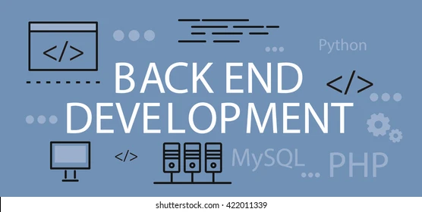
Back End - Sriram Srinivasan
Connect to Firebase
Hosting service
Real-time database
Authentication
Create Cloud functions
Need a backend component to integrate data into app
(Ex: dining menu, sports schedule, social events, etc.)
Design database schema & Entity / Relationship diagrams
Why Node.JS framework?
- Can use JavaScript for frontend and backend
- Is it a faster app development?
- Can application be easily scaled?
- How can we handle more I/O requests without sacrificing time?
Notes:
What are our requirements? For backend, we can connect to firebase since it is easier for the sponsors and the students ourselves to develop and maintain in future, which is a hosting service from Google that helps us with hosting, feeding the app with real-time updates to database, and can create cloud functions. The reason why we need a back end component to properly integrate the data into the app. For instance, this includes dining menu, sports schedule, social events from a certain college, etc. In addition, we also need to design a database schema and an Entity / Relationship diagram so all components of back end development functionally works. We use Node.JS framework because both frontend and backend uses javascript. Can the apps be developed faster and scaled easily? Can we handle more I/Q requests without sacrificing time?

Slide 6

Full Stack - Fitri Rozi
Integrate Firebase and React Native
Talk to APIS from different departments
Web Scraping
Unit Testing
Write documentation
Review code
Follow proper convention
Provide comments
Reusability
Provide authentication for user customization

Slide 7
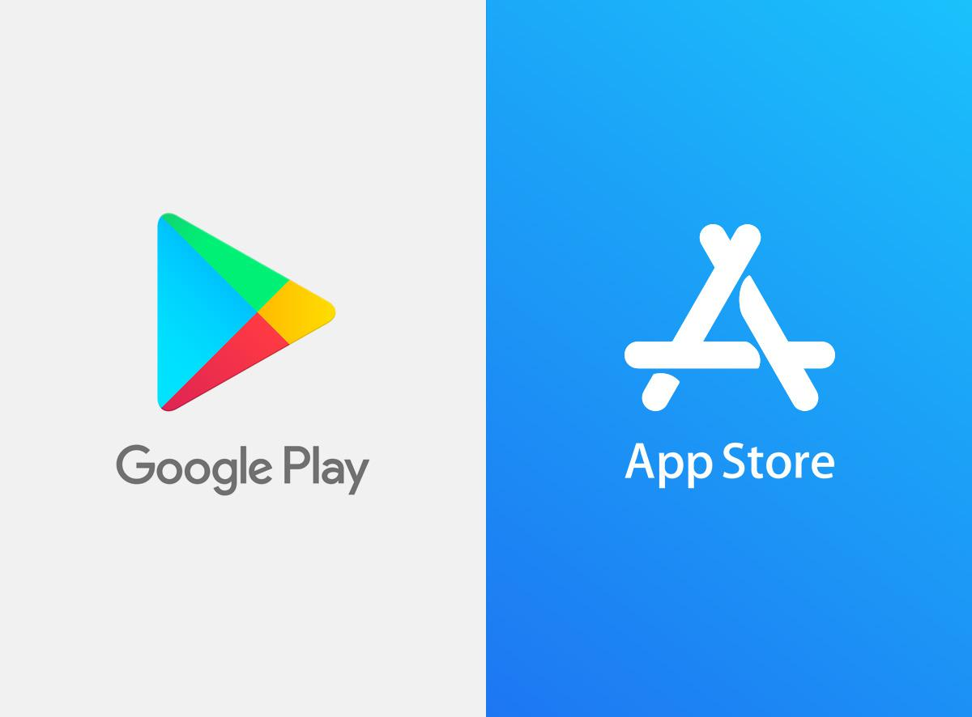
Team Lead - Karishma Bhakta
Collect feedback from students
Determine the overall cost of the project
Get approval from App store and Google Play Store to submit the mobile app
Requires developer Certification
Follow Agile project management
Notes:
Our Testing audience will be a group of 5 students in Dr. Rangel’s class. We plan on collecting the feedback from these students through a form which will ask them specific questions such as what were some difficulties they faced while using the app, what can be done to improve the app, and what they enjoyed about the app. We are currently still determining the overall cost of the project as we are still gaining more information from our sponsor, Dr. Rangel.
Moving on to making our project into a mobile app, there is an ongoing research going on for us. To start off, an Apple Developer Program membership is required by Apple. We would also need a developer certification in order to publish our app on Google Play Store.
To publish our app, we would need to comply with the App Store requirements and Google Play requirements. The App store has more in depth requirements such as having owners name + contact info, keywords, marketing URLS and TestFlight beta testing. Google Store on the other hand has basic requirements such as a graphic, privacy policy, and short description for the app. If our app is rejected by either Apple or Playstore, we would receive emails describing our issue. Once we fix our issue, we can re-submit our app.
We will be following the agile approach so everyone can work through the project, and everyone can know whats done, what is pending, AGILE-- project management (PLAN, DESIGN, DEVELOP,TEST, DEPLOY)
,, how will we do it --SCRUM, (TRELLO)--it is a software tool used to collaborate with team members and manage the project tasks

Slide 8
Q&A’s?

Slide 9
Thank you !
Thank you for your time

